Slide 1
Chapter 1
The Foundations of Quantum Mechanics

Slide 2
Lecture 1. The Historical Background of Quantum Mechanics
Physics in the Late 19th Century
Three Famous Experiments (Black-Body Radiation, The Photoelectric Effect, and Atomic Spectra)
De Broglie Matter Wave
The Uncertainty Principle

Slide 3
1.1 Experimental Foundations of Quantum Mechanics
Classical Physics
Maxwell
Electromagnetic Theory
Gibbs-Boltzman
Statistical Mechanics
Newtonian Mechanics

Slide 4
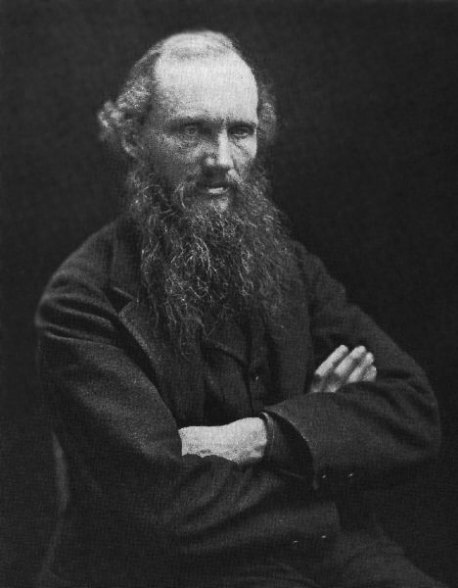
“There is nothing new to be discovered in physics now. All that remains is more and more precise measurement.”
Can all the phenomena in nature be explained by classical mechanics?
Lord Kelvin
《Nineteen-Century Clouds over the Dynamical Theory of Heat and Light》

Slide 5

Black-body radiation
Aether drift
Representative experiments that cannot be explained by classical physics include black-body radiation, the photoelectric effect, and the line spectrum of hydrogen.

Slide 6
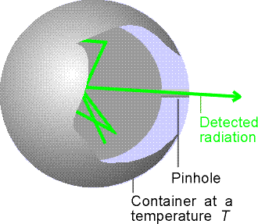
1.1.1 Black-Body Radiation and Planck’s Quantum Hypothesis
The spectral density of electromagnetic radiation emitted by a black body in thermal equilibrium at a given temperature T.
A black body is an idealized physical body that absorbs all incident electromagnetic radiation, regardless of frequency or angle of incidence.

Slide 7
Experimental Observation:
The shape of the spectral distribution only depends on the temperature of the black body while it is independent of the shape and chemical composition of the cavity.
E(λ)
E_{λ}： the strength of black-body radiation
E_{λ}dλ：emitted energy per unit time and per unit surface area in an energy range dλ
1700 ºK
1500 ºK
1300 ºK
1100 ºK
λ
0 1 2 3 4 5 6
(μm)

Slide 8
Explanation from classical physics
Wien’s displacement law
Wien distribution law
Thermodynamics + Electromagnetic radiation
Can only be used to describe the short wavelength (high frequency) spectrum

Slide 9
Explanation from classical physics
Rayleigh-Jeans equation
Statistical mechanics + Electromagnetic radiation
Can only be used to describe the long wavelength (low frequency) spectrum
Ultraviolet Catastrophe

Slide 10
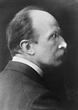
Planck’s postulate
The energy of oscillators in a black body is quantized, and is given by
E = nε₀ = nhv n=0,1,2…
where v is the frequency of the oscillator，
h is Planck’s constant which equals 6.626×10⁻³⁴J.s , and n is a quantum number which is an integer.
Planck

Slide 11
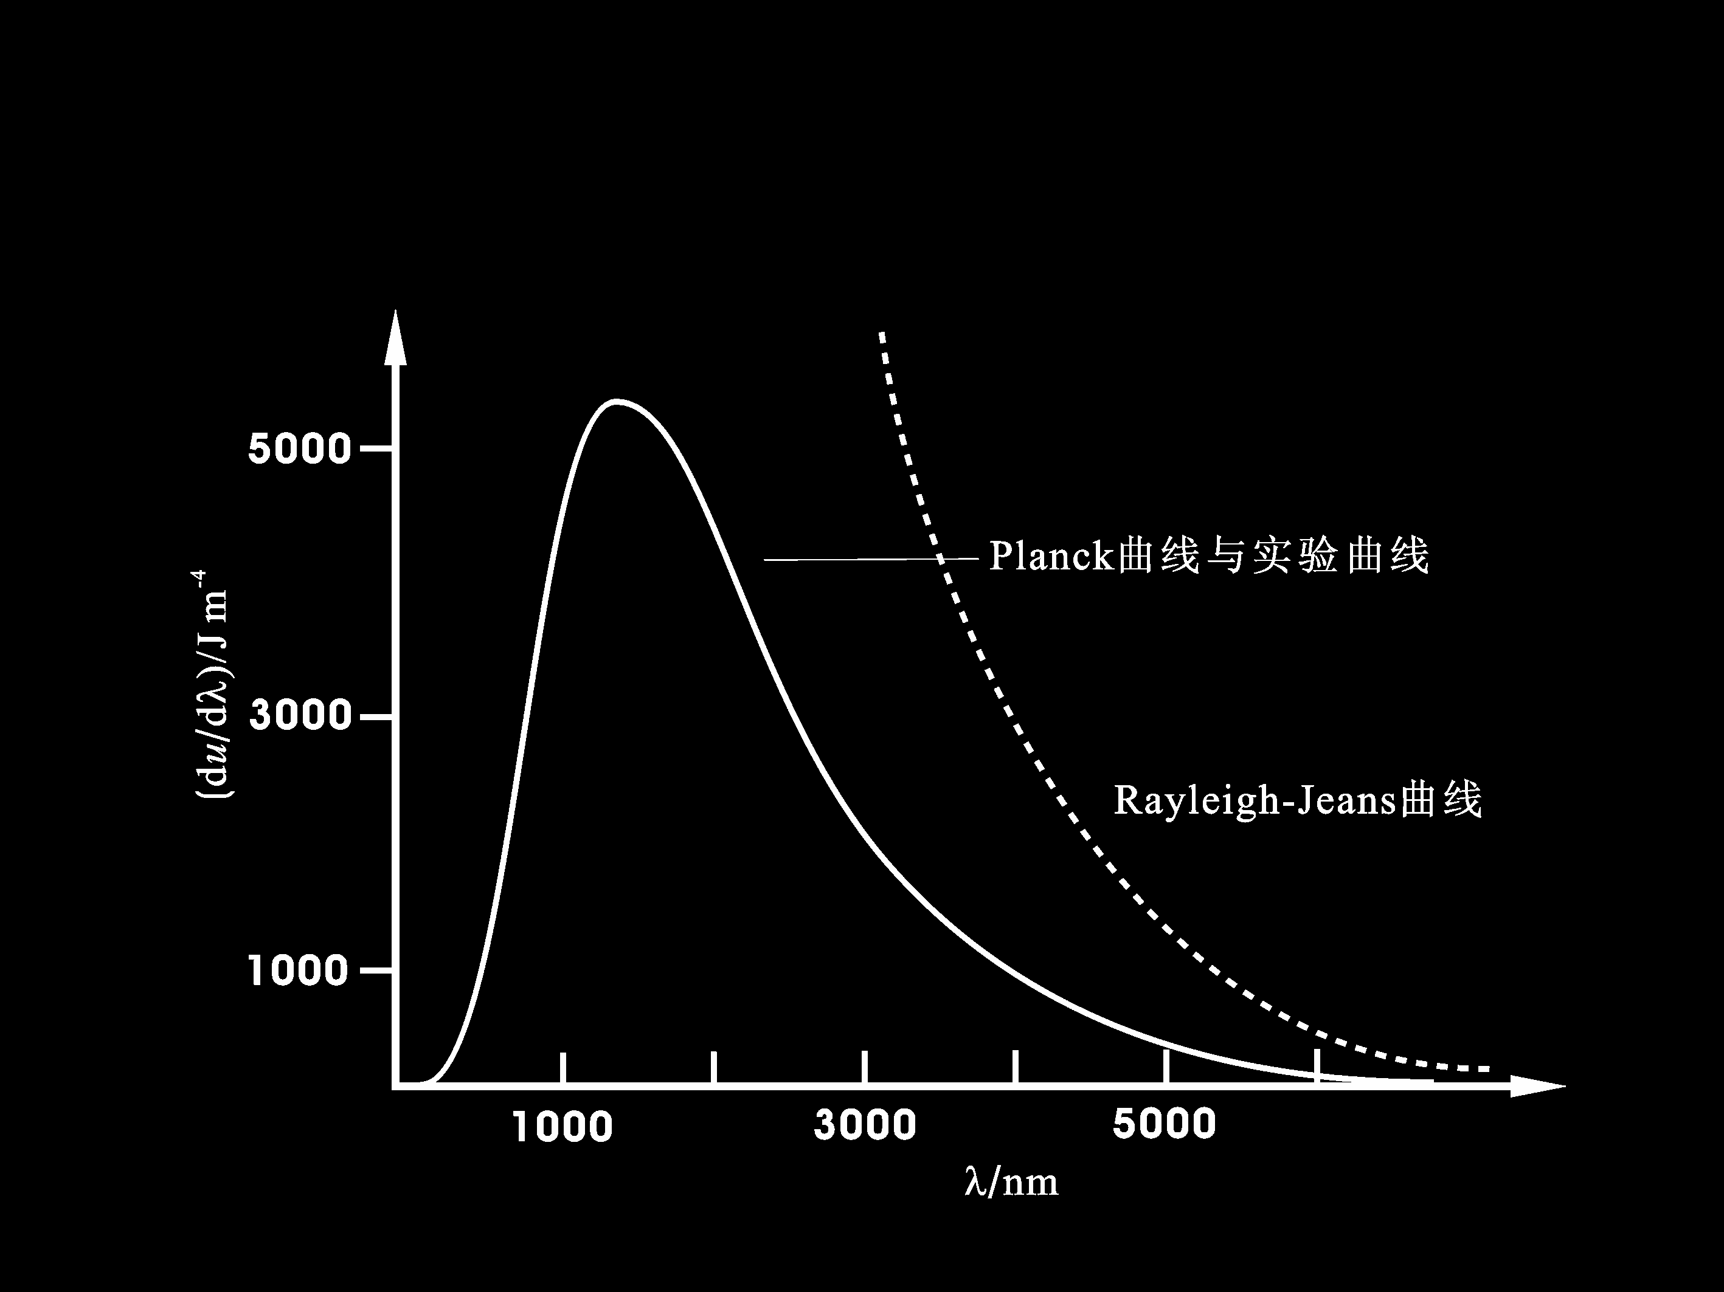
Planck’s postulate
Planck’s Equation
1-1

Slide 12
Planck’s postulate was the seed of quantum theory.
Planck received the Nobel Prize in Physics 1918.
Planck

Slide 13
1.1.2 The photoelectric effect and Einstein’s quantum theory of light
The photoelectric effect
A
When light hits the cathode K, the energies of some free electrons of the cathode metal increase, and these free electrons become photoelectrons and come out of the metal surface. Experimental observations are:
K
G
V
● Photoelectrons can be formed only when the frequency of light is higher than the threshold frequency ν₀, and different metals give different ν₀ (ν₀ of most metals are located in the ultraviolet light region).
● The number of emitted electrons increases with the increase of the light intensity. However, the light intensity doesn’t affect the initial kinetic energy of photoelectrons.
Cathode K is the inner wall of glass bulk coated with metal or metal oxide, and the glass bulk is vacuumed.
Anode A is a wire mesh.
● Increasing the frequency of light would also increase the initial kinetic energy of photoelectrons.

Slide 14
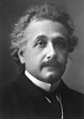
Einstein’s quantum theory of light
1
Light is a flow of photons. Photon energy is the energy carried by a single photon. The amount of energy is directly proportional to the photon's electromagnetic frequency.
The equation for photon energy is
ε=hv
h-Planck’s constant，v-the frequency of light
Einstein
2
Photon has energy (ε) and mass (m). However, the rest mass of photon is zero. According to the mass–energy equivalence (ε=mc²), the mass of a photon is given by
m =εc⁻² = hvc⁻².
Therefore, photons with different frequencies have different masses.
3
Photons have momentum (p=mc=hv/c=h/λ).
4
The intensity of light depends on the number of photons per unit of volume (i.e., the density of photons).

Slide 15
Explanation for the photoelectric effect
The photoelectric effect is the emission of electrons when electromagnetic radiation, such as light, hits a material (e.g., metal). Electrons emitted in this manner are called photoelectrons. Part of the photon energy absorbed by an electron is used to break through its binding with the metal, and the other part of the photon energy is converted to the kinetic energy of the electron.
1-2
where W is the work function which refers to the minimal energy for the emission of electrons and equals hv₀, and E_{K} is the kinetic energy of electron.

Slide 16
1-2
The above equation explains the experimental results on the photoelectric effect:
when hv＜W , photons cannot provide enough energies for the emission of electrons, and the photoelectric effect doesn’t occur;
when hv=W , v equals the threshold frequency (v₀) of the photoelectric effect;
when hv＞W , the emitted electrons have kinetic energies, and their kinetic energies are independent of the intensity of the light and increase with the increase of v. However, increasing the intensity of light would increase the number of photons per unit of volume, and thus would increase the number of emitted electrons.

Slide 17
Wave-particle duality of light
History:
Classical particle theory of light (Newton, 1680)
Classical wave theory of light (Huggens, 1690)
Maxwell proved in the 19th century that light is electromagnetic wave
Einstein proposed in the early 20th century that light has wave-particle duality

Slide 18
Wave–particle duality is the concept in quantum mechanics that every particle or quantum entity may be described as either a particle or a wave.
1-3
interaction
particle
wave
propagation
1-4

Slide 19
Both-particle-and-wave view:
particle character： ε P light intensity ∝ ρ
wave character： ν λ light intensity ∝ |ψ|²
Therefore, ρ=k|ψ|² or ρ∝|ψ|²
Phenomena such as interference, diffraction, and polarization correlate strongly with the wave character, while phenomena such as reflection, absorption, and scattering correlate strongly with the particle character. Light exhibits properties of both waves and particles. Particle is localized in position space, while wave is not. Photon energy is quantized.

Slide 20
1.1.3 The line spectrum of hydrogen and the Bohr model of atom
Atomic spectra
When atoms are excited, they emit light of certain wavelengths which correspond to different colors. The emitted light can be observed as a series of colored lines with dark spaces in between; this series of colored lines is called a line or atomic spectra.
The line spectrum of hydrogen
Balmer noticed that a single wavelength had a relation to every line in the hydrogen spectrum that was in the visible light region and proposed Balmer’s formula. In 1888, Rydberg generalized Balmer’s formula for all transitions of hydrogen:
~
(n_{i}=1,2,3…)

Slide 21

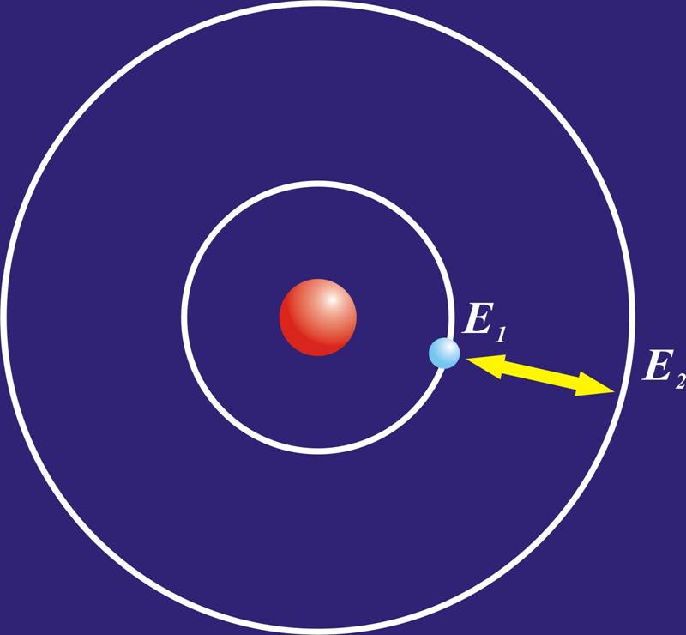
Atom models
Thomson
Plum pudding model
Rutherfold
Planetary model
Bohr
Bohr model

Slide 22
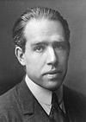
Bohr model of atom
（1）
An atom has a state with constant energy —— stationary state (the state with the lowest energy is called ground state and the other states are called excited states). Electrons at stationary state do not radiate energy.
（2）
Stationary state (E₂) → stationary state (E₁) transition radiation
Bohr
（3）
Orbital angular momentum of an electron
The model's key success lays in explaining the Rydberg formula for the spectral emission lines of atomic hydrogen.
However, the model can only be applied to calculate the energies of the allowed orbits of the hydrogen atom and other hydrogen-like atoms and ions, i.e., the model is very limited in terms of size. Poor spectral predictions are obtained when larger atoms are in question.

Slide 23
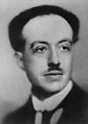
1.2 The wave-particle duality of matters and the uncertainty principle
1.2.1 The wave-particle duality of matters
Here matters refer to particles that have non-zero rest mass (m₀≠0).
Examples include electrons, protons, neutrons, atoms, and molecules.
（1）De Broglie hypothesis
Matter wave: matter behaves like a wave.
Matter waves are referred to as de Broglie waves.
De Broglie

Slide 24
De Broglie relation
1-5
1-6
The velocity of de Broglie wave is equal to phase velocity (u) but is not equal to the velocity of a particle (v); De Broglie waves can travel in vacuum, thus are not mechanical waves; De Broglie waves are generated by the movements of charged or neutral particles, thus are not electromagnetic waves.

Slide 25
By relating a free particle with a momentum p and one-dimensional motion (V is a constant or zero) to a one-dimensional plane monochromatic wave, one can obtain the one-dimensional wave function of a matter wave.
1-7

Slide 26
（2）evaluation of de Broglie wavelength
When the velocity of a free particle with a momentum p is much lower than the velocity of light（ν<<c）
1-8
For particles such as electrons, their de Broglie wavelengths are expressed in Å.

Slide 27
example
Calculate the de Broglie wavelength for a moving electron with a velocity of 1.0×10⁶m·s⁻¹
λ=
=（6.6×10⁻³⁴J·s）/(9.1×10⁻³¹kg×1.0×10⁶m·s⁻¹)
= 7×10⁻¹⁰m = 7Å
Comparable in magnitude with the size of a molecule, indicating that the wave-like behavior of a moving electron in an atom or a molecule is important. However, it is trivial at macro level.

Slide 28
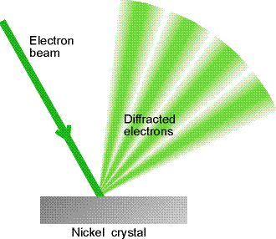
（3）experimental verification of De Broglie wave
For V=10²～10⁴V，the theoretically predicted de Broglie wavelength of an electron ranges from 0.12 to 1.2 Å, which is close to that of x-ray (0.1～100 Å). Therefore, a normal grating (period >> Å) cannot measure it.
Davisson experiment——single crystal of Ni（C.J.Davisson）
Thomson experiment——polycrystal of Au and V（G.P.Thomson）

Slide 29
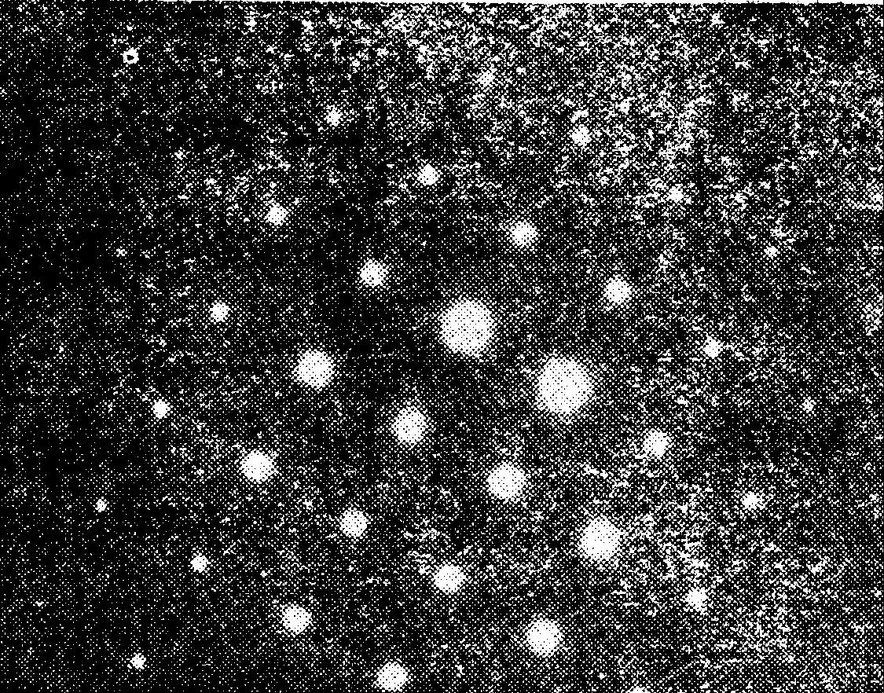
electron diffraction experiment on a single crystal by Davisson
Diffraction of electron on a single crystal Au
The wavelength λ of electron diffraction calculated by Bragg equation ( ) matches well with the result from the electron diffraction experiment on a single crystal by Davisson and Germer.

Slide 30
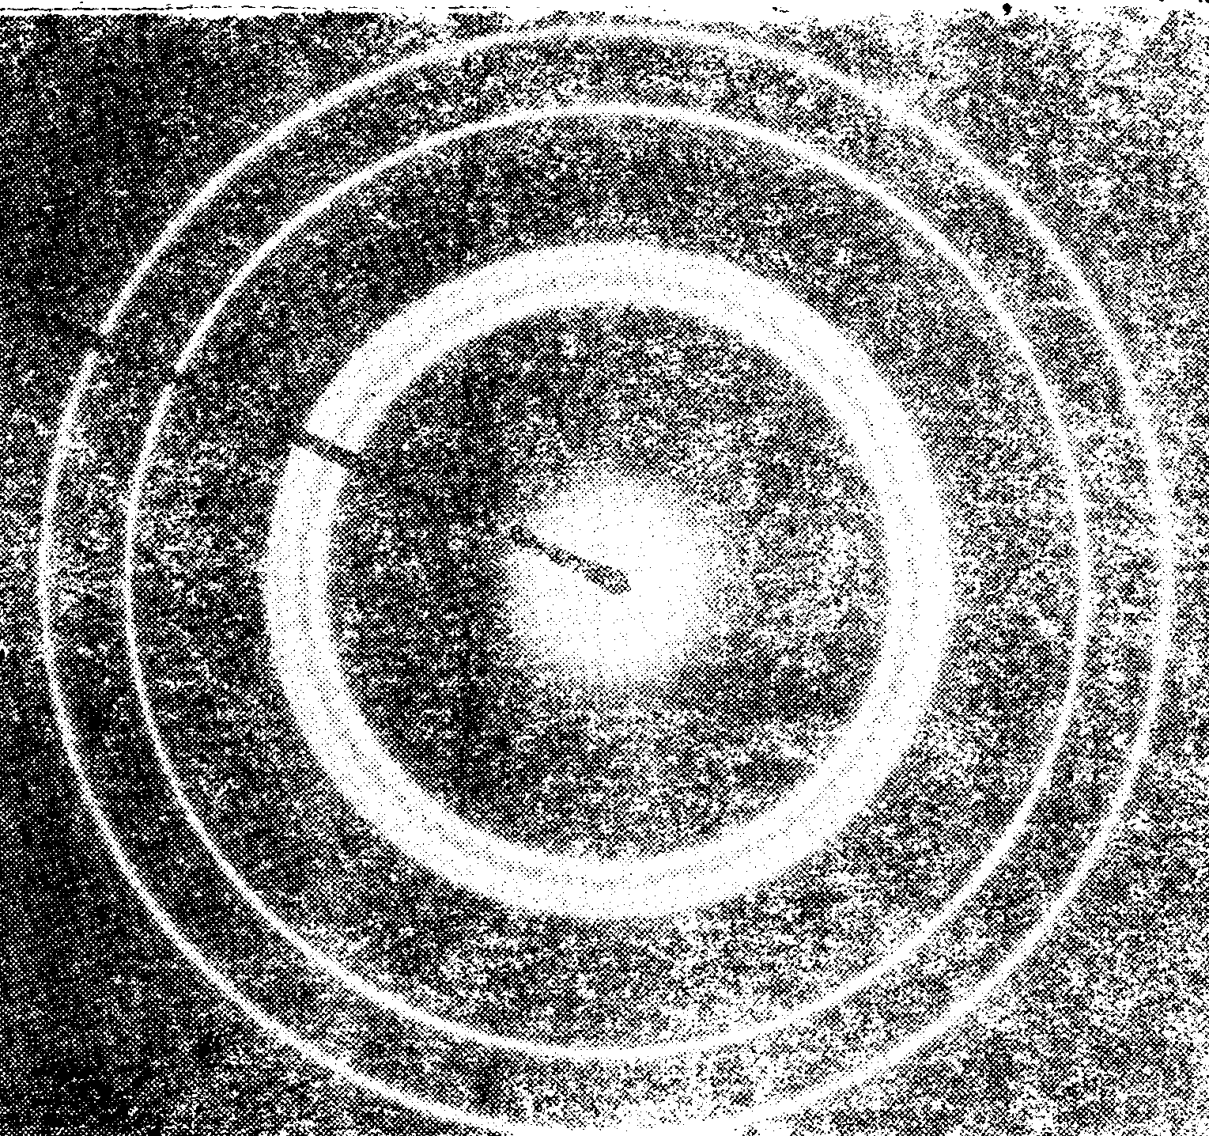
Electron diffraction experiment on a polycrystal by Thomson
Electron diffraction of an electron on a polycrystal of Au and V
λ can also be calculated from the radius of the pattern and the distance between the film and the source. The theoretical prediction matches well with the experiment.

Slide 31
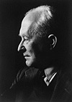
（4） statistical interpretation of De Broglie wave
In 1926, Born introduced the statistical interpretation of matter wave. He stated that the probability density of finding a particle at a given point is proportional to the square of the magnitude of the particle’s wavefunction (|ψ|² ) at that point. Matter waves described by the Born rule are called probability waves.
Born

Slide 32
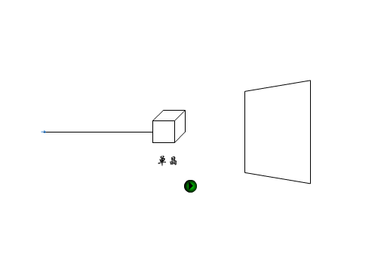
The wave-like property of electron is associated with its statistical behavior. For the case with a large amount of particles, there are more particles in the place with higher intensity of diffraction (i.e., the magnitude of wavefunction) , and vice versa. The final location of a particle travelling through a crystal cannot be accurately predicted. If the experiment is repeated using particles with the same velocity, the particles tend to be found at places with high intensity of diffraction.

Slide 33
Consider the electron diffraction pattern of a polycrystal powder:
The electron density at point (x,y,z) is:
Intensity of wave ∝|ψ|²
Electron density is proportional to the intensity of matter wave: ρ∝|ψ|²
Probability density is proportional to the intensity of matter wave

Slide 34
The similarity and difference of the physical
meanings of matter wave and mechanical wave
A mechanical wave is wave that is an oscillation of matter, and an electromagnetic wave is a wave that is created as a result of vibrations between an electric field and a magnetic field. However, matter wave doesn’t have a physical meaning. The strength of matter wave shows the probability density of finding a particle (the so-called probability wave). However, matter wave behaves like classical wave in terms of coherence. These phenomena show the unique feature of a quantum system.

Slide 35

1.2.2 the uncertainty principle
In quantum mechanics, the uncertainty principle is any of a variety of mathematical inequalities asserting a fundamental limit to the precision for the measurement of the values of certain pairs of physical quantities of a particle, such as position (x) and momentum (p).
1-10
We can also conclude:
Heisenberg

Slide 36
The above equations imply that the uncertainty of momentum times the uncertainty of position is not smaller than a constant h. The uncertainty principle states that the more precisely the position of some particle is determined, the less precisely its momentum can be predicted from initial conditions, and vice versa.
canonical conjugate
Time-energy uncertainty relation: Δt·ΔE≥h
where ΔE is the difference of E₁ and E₂ measured at time t₁ and t₂, respectively.

Slide 37
Application
The uncertainty principle can be applied to distinguish a quantum system from a classical system.
Statements
(1) Position x and its momentum cannot be predicted simultaneously. The above relationship is inapplicable to Δx and Δp_{y}.
(2)The uncertainty principle can also be applied to macroscopic systems. However, it is trivial.

Slide 38

Calculate the uncertainty of the velocity of a dust with mass of 10⁻¹⁵kg. The uncertainty of the position of the dust is 10⁻⁸m.
Example 1
It can be derived from the uncertainty principle that:
It is much smaller than the velocity of the dust（10⁻²m.s⁻¹）. For a matter with a bigger mass, Δv would be even smaller. Therefore, at macro level, position and momentum can be predicted simultaneously. Thus, classical mechanics is successful at macro level.

Slide 39
Example 2
Calculate uncertainty of the position of a bullet with mass of 0.01kg and velocity of 1000m⋅s⁻¹. The uncertainty of velocity is 1% of the velocity of the bullet.
The uncertainty of position (∆ x) is much shorter than the travel distance of the bullet. Therefore, this case can be described by classical mechanics.

Slide 40
Calculate the uncertainty of the velocity of a moving electron in an atom or a molecule. The mass of an electron equals 9.1×10⁻³¹kg and Δx equals 10⁻¹⁰m.
Example 3
Δx = 10⁻¹⁰m
Δv = h/(Δx·m)
=（6.626×10⁻³⁴J.s）/(10⁻¹⁰m×9.1×10⁻³¹kg)
≈10⁶～10⁷m.s⁻¹
The velocity of an electron is about 10⁶m.s⁻¹. Therefore, when Δx equals 10⁻¹⁰m, the uncertainty of velocity is larger than the velocity of an electron. Accordingly, classical mechanics is not applicable to electrons in atoms or molecules.

Slide 41
Example 4
The minimal distance (d) that can be measured by a microscope is given by:
where α is half of field of view and λ is the wavelength. Since the de Broglie wavelength is much shorter than the wavelength of visible light, the resolution of electron microscope is much higher than that of photon microscope.

Slide 42
The uncertainty principle reflects the wave-particle duality of a quantum system. The uncertainty principle helps people understanding a quantum system. Quantum mechanics was established to describe quantum particles that have wave-particle duality.

Slide 43
Comparisons on the properties of a quantum particle and a macroscopic object
macroscopic object quantum particle
Position and momentum can be predicted precisely
Can be described by classical mechanics
Position and momentum cannot be predicted precisely
quantum mechanics is necessary
Trajectory of the object can be measured
Only has a probability density
Energy is continuous
Energy is quantized
The uncertainty principle is much less important
Follows the uncertainty principle

Slide 44
1.3 basic assumptions in quantum mechanics
A quantum particle such as an electron behaves both as a particle and as a wave, and thus must be described by quantum mechanics and cannot be described by classical mechanics. Quantum mechanics was established based on a few basic assumptions, and these assumptions, just like axioms of geometry, cannot be proved. However, some principles derived from these assumptions can be used to interpret experiments and make predictions. Therefore, these assumptions can be viewed as axioms.

Slide 45
1.3 basic assumptions in quantum mechanics
1.3.1 assumption I——state wave function and probability
1.3.2 assumption II——mechanical quantities and linear Hermitian operator
1.3.3 assumption III——Schrödinger equation
1.3.4 assumption IV——(state) superposition principle
1.3.5 assumption V——Pauli exclusion principle

Slide 46
1.3.1 assumption I——wavefunction and probability
Two implications from assumption I:
（1）the state of motion of a particle can be described by a wave function.
（2）Born’s interpretation on wavefunction——|ψ(x)|² is called the probability density
Probability density of finding a particle at a given point in space

Slide 47
ψ(x, y, z, t) is a state that includes all information of a system. At a given time t, the probability of finding a particle at a given point (x, y, z) in space is proportional to |ψ(x, y, z, t)|².

Slide 48
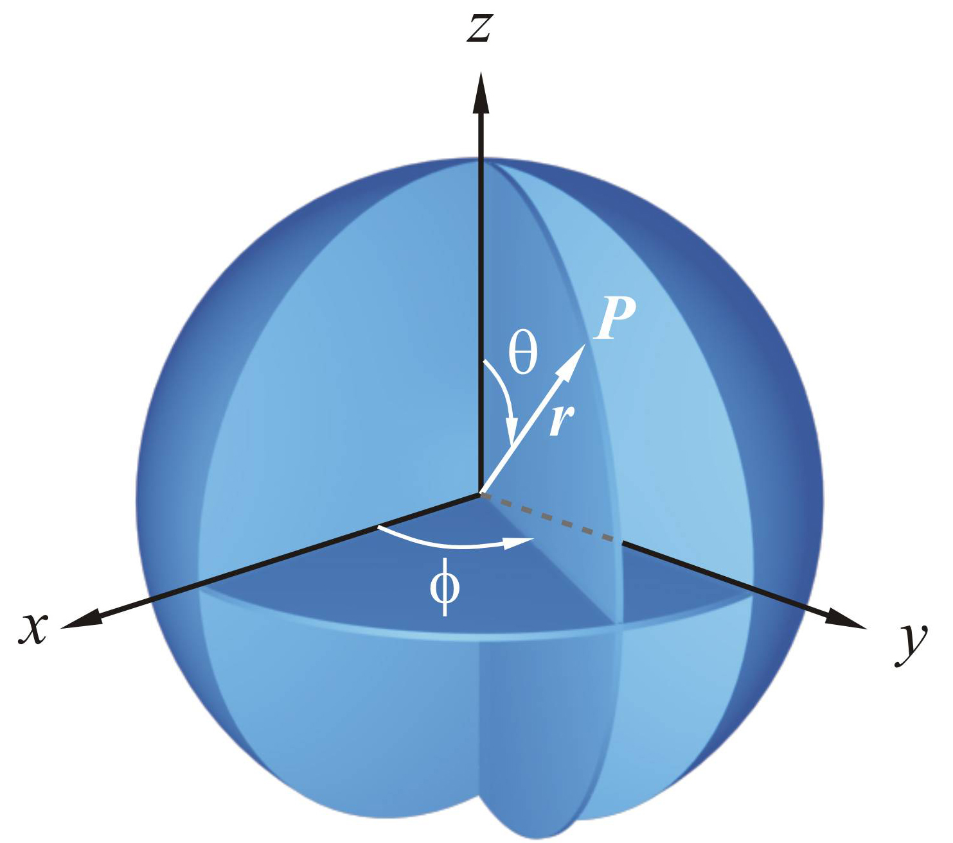
Relationship between the Cartesian coordinate system and the spherical polar coordinate system
x = r sinθ cosφ
y = r sinθ sinφ
z = r cosθ
r² = x² + y² + z²

Slide 49
Stationary state
Probability density and energy do not change over time
1-12
Comparing with
,
has one more factor
Most chemistry problems are associated with stationary properties. Therefore, the spatial part of ψ(x, y, z, t), i.e., ψ(x, y, z) is called the wavefunction.

Slide 50
Mathematical description for a normal wave: The state superposition principle for waves
The principle of linear superposition for waves: the wavefunction of two or more waves is the sum of the wavefunctions of those waves.
A wave can always be decomposed into simple harmonic waves. This is the Fourier analysis.
Good sound is generally a combination of a simple harmonic wave with a particular frequency and other simple harmonic waves with integral multiples of that frequency.

Slide 51

General requirements that a wavefunction must satisfy:
Single valued
Continuous
Square integrable

Slide 52
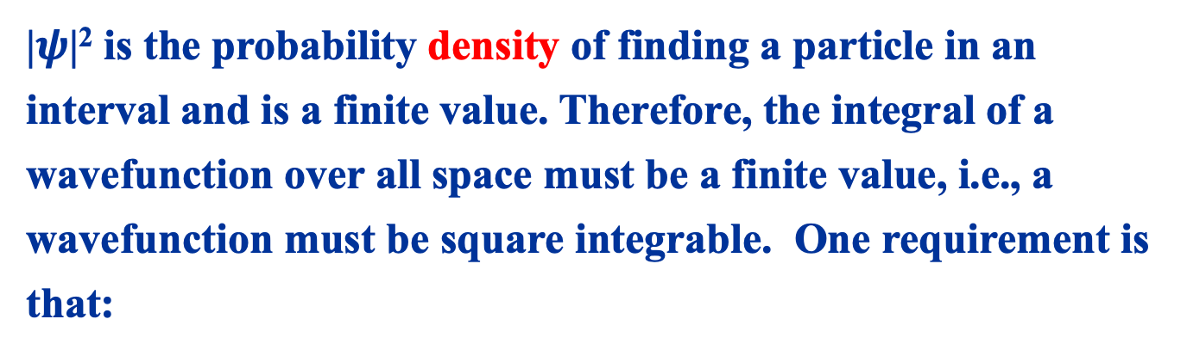
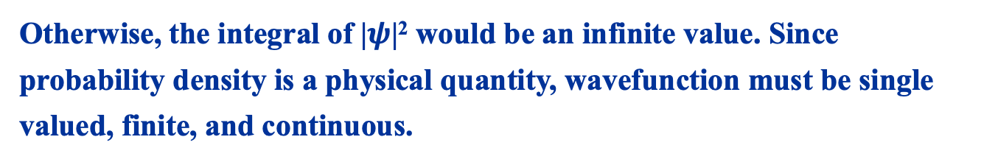
General requirements that a wavefunction must satisfy:
|$ψ$|² is the probability density of finding a particle in an interval and is a finite value. Therefore, the integral of a wavefunction over all space must be a finite value, i.e., a wavefunction must be square integrable. One requirement is that:
Otherwise, the integral of |$ψ$|² would be an infinite value. Since probability density is a physical quantity, wavefunction must be single valued, finite, and continuous.
One has to remember the above features of wavefunction!

Slide 53
The probability density of finding a particle over all space must be 1 or 0. If it‘s zero, the particle doesn’t exist. If it’s one, the particle exists, and the wavefunction must be normalized. For a wavefunction ψ:
Then:

Slide 54
Example: normalizing the following wavefunction:
Solution: normalization requires that the integral of the modulus square of a wavefunction must be 1. However, the integral of the modulus square of an unnormalized wavefunction is:
To normalize it, one just need to divide it by
Then, the normalized wavefunction is given by

Slide 55
Normalization
1-13
Normalization constant

Slide 56
Another useful concept similar to the normalization of a wave function is the orthogonality of two wave functions. The normalization of a function is similar to keeping the direction of a vector and making its length to be 1, i.e., turn the vector into a unit vector, while the meaning of two functions being orthogonal is defined that two vectors are perpendicular to each other. The method to determine whether two vectors are perpendicular require to calculate their dot product. For two functions, the definition of "dot product" is:
If the above integral is zero, then the two functions f and g are orthogonal.
Example: The well-known 1s, 2s, 2px, 2py, 2pz orbitals (and so on) of the hydrogen atom are orthogonal to each other.

Slide 57
1.3.2 Hypothesis II-mechanical quantities and linear self-conjugate (Hermitian) operators

Slide 58
The basic concepts involved in Hypothesis II:
operator, linear operator, self-conjugate operator, eigenvalue, complete set
(1) Operator: a symbol representing a certain operation
operation rules: For any function f, the operator satisfies
Scalar Multiplication
is any constant
Addition
Matrix Multiplication
Generally
， So the definition of commuting operator is:

Slide 59
（2）Linear operator
Operators satisfying the following relationships are linear operators:
(3) The eigenequation, eigenfunction and eigenvalue of the operator (It is not explicitly written in this book but used)
The following equation is called the eigenequation of the operator Â.
is complex
If f exists, f is called the eigenfunction of Â and λ is called the eigenvalue of Â. There is a many-one correspondence between f and λ, that is, one eigenvalue can correspond to one or more eigenfunctions.
The situation where one eigenvalue corresponds to multiple eigenfunctions is called degeneration.

Slide 60
Example: Prove that the operator from the first derivative operation is a linear operator, and find its eigenfunction.
Answer：
It is a linear operator that satisfies the requirements of a linear operator.
Written the eigen equation of the operator:
is constant
is any constant
The above equation is the eigenequation of the first derivative operator.

Slide 61
Example: When the electronic spin is not considered, the eigenfunction of the energy operator of the hydrogen atom is the well-known 1s, 2s, 2px, 2py, 2pz orbitals and so on. The energy of the hydrogen atom is the eigenvalue of the energy operator, among which the eigenstate corresponding to the energy of ground state is the 1s orbital (an eigenvalue corresponds to an eigenfunction), and the eigenstate corresponding to the energy of the first excited state is 2s, 2px, 2py, 2pz orbitals (an eigenvalue corresponds to four eigenfunctions).

Slide 62
(4) Self-conjugate operator
Definition: The operator that satisfies the following relationship is a self-conjugate operator:
For the functions f and g,
Example: Prove that the following operators are self-conjugate operators.
It can be seen from the proof process that if there is no imaginary number i in the above operator, the first derivative operation alone is not a self-conjugate operator.

Slide 63
Example: If A and B are both self-conjugate operators, but AB is not commutative, i.e. AB≠BA, try to prove that AB is not a self-conjugate operator.
Prove: The subject is to prove
According to the definition of the self-conjugate operator, if treating Bg as a function and knowing that A is self-conjugate, then
Considering Af as a function and knowing that B is self-conjugate, then
It can be seen from this example that though A and B are both self-conjugate operators, their product is generally not self-conjugate operator. However, if AB=BA, that is, A and B are exchangeable, then AB and BA are both self-conjugate operators.

Slide 64
The properties of the self-conjugate operator: (not explicitly written in the book but used)
(1) The eigenvalues of self-conjugate operators are all real numbers.
(2) The eigenfunctions belonging to different eigenvalues of the self-conjugate operator are orthogonal, and multiple eigenfunctions belonging to the same eigenvalue can be orthogonalized by Schmidt method.
(3) All orthogonal normalized eigenfunctions of a linear self-conjugate operator constitute a complete set.
Everything about the self-conjugate operator must be mastered.

Slide 65

A. The eigenvalues of Hermitian operators are real numbers
Conjugation
According to the definition of Hermitian operator
So a=a*, that is, a must be the real number (only the conjugate of a real number is equal to itself).

Slide 66

B. The eigenfunction system of Hermititian operator constitutes a complete set of orthogonal normalization
orthogonal normalization:
, orthogonality
, normalization
δ_{ij} is called Kronecker delta notation. The value of δ_{ij} is either 0 or 1.
Example 7
For the wave function of the hydrogen atom, there must be
and

Slide 67
B. The eigenfunction system of Hermititian operator constitutes a complete set of orthogonal normalization
Completeness:
The completeness of the eigenfunction system of Hermitian operator means that any qualified wave function Ψ that obeys the same boundary conditions as the function system can be expressed as a linear combination of them, namely
Any state Ψ of the system can be represented by the superposition of various eigenfunctions. For example, the linear combination of 1s and 2s states may also be a state of the system, which is the basis of the principle of state superposition.

Slide 68
Hypothesis II contains four meanings:
1. Each physical quantity describing a microscopic system has a corresponding linear self-conjugate operator.
2. The value of the physical quantity must be the eigenvalue of the linear self-conjugate operator corresponding to the physical quantity. (It is not explicitly written in this book but used.)
Example: The energy of a hydrogen atom can only take values in the following form:
(eV); n = 1,2,3,···
They are actually the eigenvalues of the energy operator of the hydrogen atom.

Slide 69
Each observable mechanical quantity A of the microscopic system corresponds to a linear Hermitian operator .
If established, the mechanical quantity A has a certain value a in this state. a is called the eigenvalue of the operator , and ψ is an eigenfunction that belongs to the operator and has the eigenvalue a. The equation
is called the eigenequation.
If established, the state described by ψ does not have a definite value. The average value (the average value of the extrinsic mechanical quantities) can be obtained by the following formula:

Slide 70
3. For the system in state Ψ (normalized), one can expand Ψ from the orthogonal normalized eigenfunction of physical quantity A, namely
is i-th eigenstate of A and a_{i} is the eigenvalue
When measuring the physical quantity A, the probability of obtaining a_{i} is |c_{i}|². (It is not clearly written in this book but used.)
So: In state Ψ, the average value of physical quantity A is:
Among them, a_{i} and c_{i} are the same as in point 3.

Slide 71
Example: The energy eigenfunction of a hydrogen atom can be composed of 1s, 2s, 2px orbitals and so on. If the current state of a hydrogen atom is represented by the following wave function
then, when measuring its energy, there is a 36% probability that it is in the ground state and 64% is in the first excited state. One measurement can only get one of the two, and no other value can be obtained.
After the measurement, the state of the hydrogen atom is determined. If you obtain the ground state during the measurement, the hydrogen atom will be in the ground state after the measurement. If there are multiple hydrogen atoms, then by measuring them, you can get the ground state and the first excited state with corresponding probabilities.

Slide 72
Table 1-2 operators corresponding to various mechanical quantities
mechanical quantities |  | operator
coordination coordination² momentum momentum²

Slide 73
Table 9-2 operators corresponding to various mechanical quantities
mechanical quantities |  | operator
angular momentum angular momentum² kinetic energy potential energy energy
The energy operator is also known as the Hamiltonian operator.

Slide 74
The physical quantities in classical mechanics can be expressed as functions of coordinates and momentum. Corresponding to quantum mechanics, the operators of these physical quantities just need to express the coordinates and momentum by operators.
classical mechanics
quantum mechanics
But such correspondence is not necessarily unique, for example:
At this time, it can only be determined by experiment which correspondence is correct or a combination of all these possibilities.
Some physical quantities are only available in the quantum world. The operators of these physical quantities generally cannot be expressed as functions of coordinates, such as the spin angular momentum of electrons.

Slide 75
4. The coordinates and momentum operators of a particle in the Cartesian coordinate system satisfy the relation:
The square brackets are called commutation, which is defined as:
The coordinates and momentum operators of different particles are all commutative.
It can be proved that in the Cartesian coordinate system,

Slide 76
Origin of
Free particles moving in
one-dimensional direction
Then obtain:

Slide 77
In spaces of different dimensions，the energy operator can be written by：
1. One dimension：only one direction，no rotating，thus angular momentum makes no sense, e.g. one direction vibrating spring.
Kinetic energy:
Potential energy:
Total energy:
2. Three dimensions：three directions，rotating，thus angular momentum makes sense, e.g. the hydrogen atom is always in three dimensions.
Kinetic energy:
Potential energy:
Total energy:

Slide 78
e.g. The wave function of a particle is：
Please calculate the mean values of momentum and the square of momentum of this particle.
Formula is given:
Solution：

Slide 80
e.g.
Continue with last question, please calculate the mean values of coordinate x and x², and verify the indeterminacy relationship:
Solution：

Slide 81
（5）Perfect set（FYI）
1. Perfect set：A set of some orthogonal normalized functions, and an arbitrary wave function can always be expressed as a linear superposition of the functions in this set.
e.g. Set
All square integrable functions on the interval [0，2π] can be expressed as the linear superposition of the above-mentioned functions. This is what we learned before to express a function as a Fourier series.
2. All orthogonal normalized eigenfunctions of a linear self-conjugate operator constitute a complete set. In this way, it is possible to assume that a wave function in hypothesis II can always be expressed as the superposition of the eigenfunctions of a certain quantity.

Slide 82
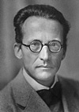
1.3.3 Postulate III——Equation of state for microparticles
W.K.Heisenberg proposed matrix mechanics in 1925.
E.Schrödinger created wave mechanics in 1926.
Heisenberg won the physical Nobel Prize in 1932.
P.A.M.Dirac describe quantum mechanics with operators.
Schrödinger and Dirac shared the physical Nobel Prize in 1933.
E.Schrödinger

Slide 83
Microparticles satisfy the equation
—Time-dependent Schrödinger equation
1-15
∇² is Laplace operator, the specific expression is:

Slide 84
Requirements of Schrodinger equation for wave function:
Energy operators generally contain second-order derivatives with respect to coordinates, so Schrodinger equation is usually a second-order partial differential equation. This requires the wave function to be single-valued, continuous and differentiable, otherwise, the derivation operation cannot be performed.
Schrodinger equation requires continuous differentiability of the wave function, which could be relaxed in some cases, but this course will not encounter such a situation.

Slide 85
For stationary state, coordinate variables can be separated from time variables：
1-16
Substitute (1-16) into (1-15)，devide by ψφ, then obtain:
1-17

Slide 86
The solution is:
1-18
Stationary Schrodinger equation（First equation）
denoted as energy egienequation
1-19
denoted as Hamilton operator

Slide 87
e.g. Schrodinger equation of hydrogen atom. These two problems can be simplified into one problem, just consider the relative motion of the electron and the nucleus. This is similar to that the electrons move around the nucleus while the nucleus does not move.
Kinetic energy:
Potential energy:
Schrödinger equation:

Slide 88
Explanation of
Schrodinger Equation
Assume that the movement of a free particle with a certain energy E and momentum p moving in the x direction, which is equivalent to a plane monochromatic wave, and the wave function is:
T represents kinetic energy, substitute T=p_{x}²/2m into the formula above, obtain:
This is an equation satisfied by one-dimensional free particles. Each free particle has a certain kinetic energy (T) and potential energy (V=0).

Slide 89
For non-free particles, substitute T=E-V into last formula, obtain:
1-20
In three dimensions, it can be written as:
1-21
Any stationary wave function must satisfy this basic equation. The potential energy in the equation is a function of coordinates, and its form depends on the specific situation.

Slide 90
1.3.4 Postulate IV——Quantum superposition
If ψ₁,ψ₂, … ψ_{n} are the possible states of a certain microscopic system, ψ obtained from their linear combination is also the possible state of the system, thus
1-22
where c₁,c₂, … c_{n} are linear combination constants, and the probability of each ψ_{i} in the state of ψ is |c_{i}|².
From the formula of the average value of the extrinsic mechanical quantities,
1-23
Obviously, when the system is in the state of , the average value
is the weighted average value of .

Slide 91
Example 8
For particles in one-dimensional potential box, the corresponding energy of , are E₁ , E₂ ,respectively. Find the average value of energy when the system is .
Example 9
ψ_{2s},ψ_{2px} are two atomic orbitals forming sp hybridization, find their hybrid wave functions.
The size of the s and p components in the hybrid orbital is determined by the combination coefficient c_{ij}.

Slide 92

1.3.5 Postulate V——The Pauli exclusion principle
Besides space motion, microparticles also perform spin motion. The complete wave function of identical microparticles including spin. When coordinates are exchanged between any two particles (including space and spin coordinates), for the boson system (the spin quantum number is zero or an integer) is symmetric, but for the fermion system (the spin quantum number is a half-integer) is antisymmetric.
In the same atomic or molecular orbital, only two electrons can be accommodated at most, and the spin states of the two electrons must be opposite. In other words, two electrons with the same spin cannot occupy the same orbit.

Slide 93
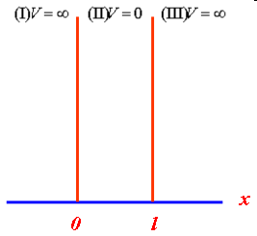
1.4 Application examples of stationary Schrodinger equation
1.4.1 The Particle in a One-Dimensional “Box”
Imagine that a particle with mass m is free to move along the x axis between x=0 and x=L, with no change in potential (see Figure on the right). Although the one-dimensional potential box is an abstract ideal model, some practical systems, such as free electrons in metals, delocalized bond electrons in chemistry, etc., can be approximated as one-dimensional potential box models.

Slide 94
（1）Schrodinger equation
Outside of the box：
Inside of the box：
Stationary Schrodinger equation:
The characteristic equation is:

Slide 95
Linear homogeneous differential equation
y′′+py′+qy=0
It is called the second-order homogeneous linear differential equation with constant coefficients , where p and q are constants .
If y₁ and y₂ are two linear independent solutions of the second-order homogeneous linear differential equation with constant coefficients, then y=C₁y₁+C₂y₂ is its general solution.
if r can be appropriately selected to make y=e^{rx} satisfy the second-order homogeneous linear differential equation with constant coefficients, substitute y=e^{rx} into equation y′′+py′+qy=0,
then obtain:
(r ²+pr+q)e^{rx} =0.
It can be seen that , as long as r satisfies the algebraic equation, r²+pr+q=0, the function y=e^{rx} is the solution of the differential equation.

Slide 96
Linear homogeneous differential equation
characteristic equation: r²+pr+q=0 is the characteristic equation of the differential equation with y′′+py′+qy=0 .
The roots of characteristic equation (r₁、r₂) can be calculated via
、
The relationship between the root and the general solution of
the characteristic equation:
(1) When the characteristic equation has two unequal
real roots (r₁、r₂)
、
are two linearly independent solutions of the equation.
、
solve that equation, also
is not a constant.
.
So the general solution of the equation is

Slide 97
Linear homogeneous differential equation
The characteristic equation has two equal real roots (r₁=r₂), r₁=-p/2，
、
are two linearly independent solutions of second order homogeneous linear differential equations with constant coefficients.
Because,
solve that equation, also
So
also solve that equation, and
is not a constant.
So the general solution of the equation is
.

Slide 98
Linear homogeneous differential equation
The characteristic equation has a pair of conjugate complex roots
r_{1, 2}=α±iβ，that is to say
y=e^{(α+iβ)x}、y=e^{(α−iβ)x} are the solution of two linearly independent complex number forms of differential equations.
y=e^{αx}cosβx、y=e^{αx}sinβx are the solutions of two linearly independent real number forms of differential equations .
y₁=e^{(α+iβ)x} and y₂=e^{(α−iβ)x} solve that equation, by Euler's formula
y₁=e^{(α+iβ)x}=e^{αx}(cosβx+isinβx),
y₂=e^{(α−iβ)x}=e^{αx}(cosβx−isinβx),
y₁+y₂=2e^{αx}cosβx,
y₁−y₂=2ie^{αx}sinβx,
So e^{αx}cosβx、e^{αx}sinβx also solve that equation
(linearly independent)
General solution
y=e^{αx}(C₁cosβx+C₂sinβx )

Slide 99
General solution：
★ Determine the special solution of the equation according to
the boundary conditions
Since ψ must be continuous，that is ψ(0)= ψ(l)=0，So
1-24
1-25

Slide 100
★ Normalization coefficient determined in accordance with
the normalization condition
1-26
n=1,2,3,…
1-27

Slide 101

（2）Discussion of solution results
A Energy quantization
Energy level equation indicates energy of microscopic particles with bound state is discontinuous. This is the energy quantization effect of the microscopic system. The interval between two adjacent energy levels is
The difference of energy level is inversely proportional to the mass of particle and the square of the particle's range of motion. This indicates that quantization is characteristic of the microscopic world.
For a given n，E_{n} is inversely proportional to l². The range of particle motion increase and the energy would decrease. This is the source of delocalization energy of large π bond in chemistry.

Slide 102
B Zero-point energy effect
Energy level equation indicates that the minimum energy of the system cannot be zero. Since the potential energy in the box is 0 (V=0)，this means that the minimum kinetic energy of the particle is always greater than zero，which is called the zero-point energy effect. The minimum kinetic energy is always greater than zero means that the particles are always in motion, that is, the motion is absolute. Zero point energy has practical significance in some cases including theoretical calculations of molecular vibrational spectroscopy, isotope effects, and thermochemical data.

Slide 103
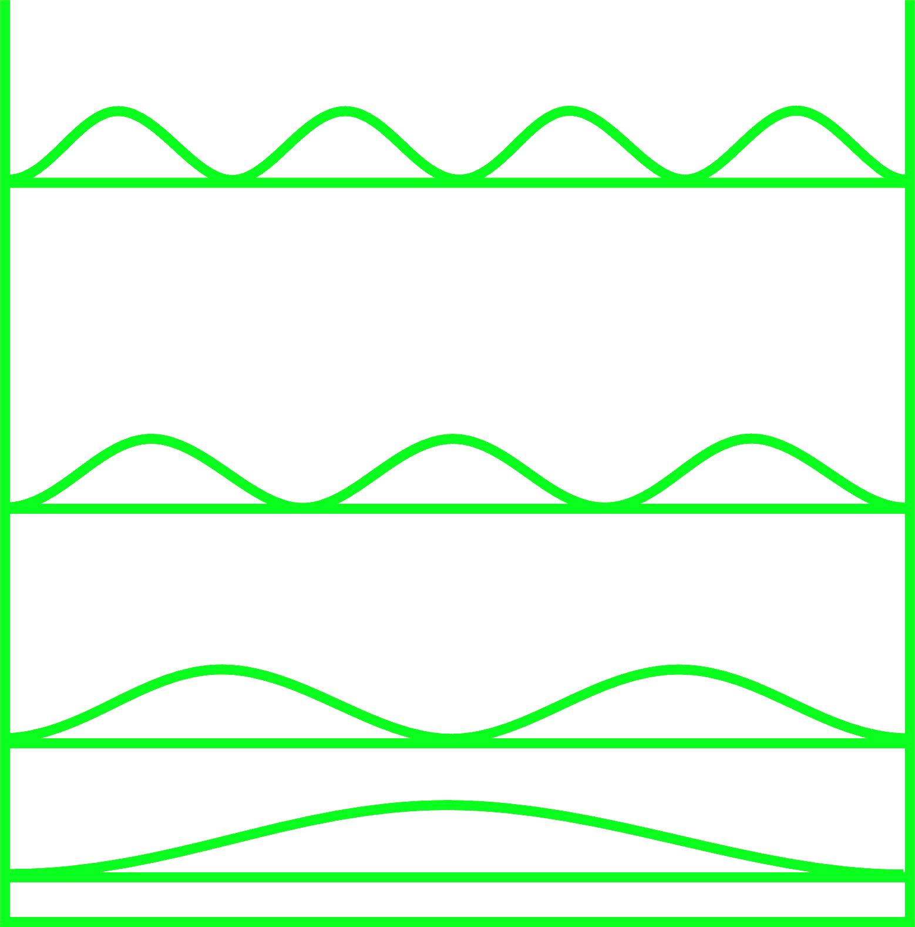
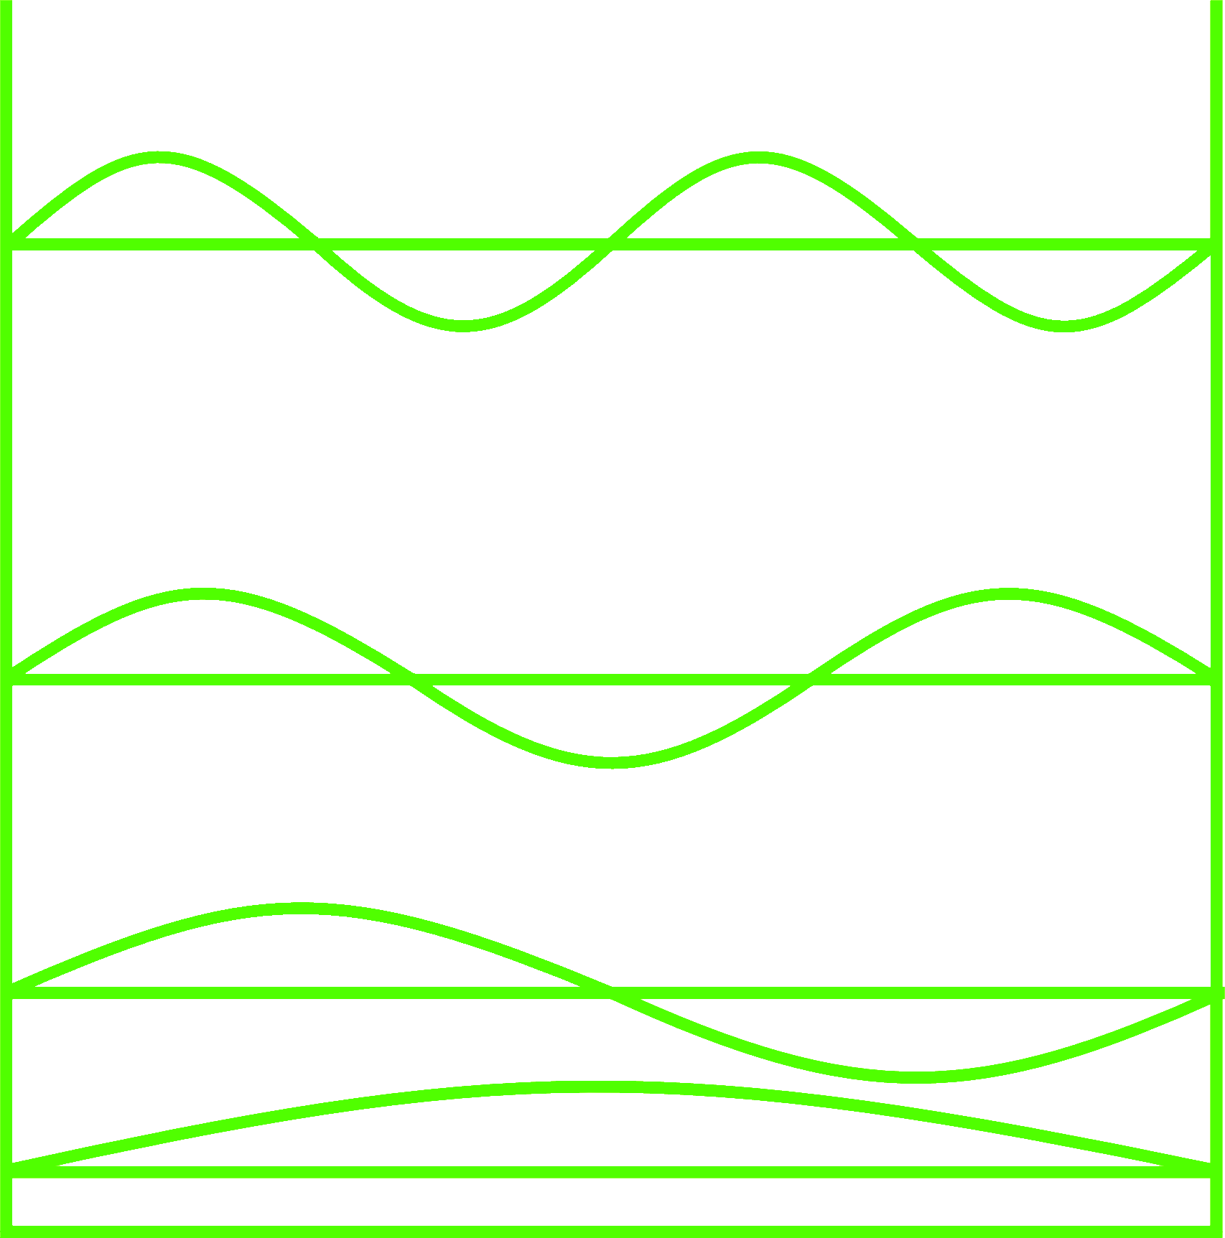
C Wave function and probability density
n=4
n=3
n=2
n=1

Slide 104
C Wave function and probability density
Probability Density
Wave Function

Slide 105
These phenomena(e.g., energy quantization, zero-point energy effect, and particles having no motional orbits only have probability distribution) are not available in classical situations, and can only be obtained in quantum situations. They are generally called "quantum effects".

Slide 106
D Orthonormality of wave function

Slide 107
E Related physical quantities of one-dimensional box

Slide 108
1.4.2 Particles in motion in a three-dimensional box
Potential function
Schrodinger equation
1-28

Slide 109
if
1-29
1-30
So：
1-31
divided by XYZ，and sort out：
1-32

Slide 110
1-34
1-35
Three quantum numbers are needed to describe a three-dimensional space state. The quantum numbers (n, l, m) will also be used when discussing the spatial wave function (space orbit) of electrons.

Slide 111
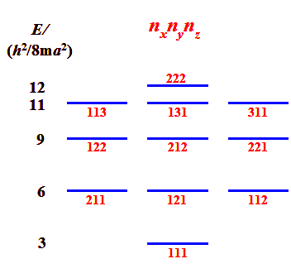
Degenerate state of particles in three- dimensional infinite cubical potential well
If a=b=c，potential well is a cube，level written as
These states corresponding to the same energy level are called degenerate states.
Degeneracy is defined as the number of states corresponding to the same energy level. The degeneracy is usually related to symmetry, and the reduction of symmetry often reduces or even completely destroys it.

Slide 112
Example10
Find the number of possible motion states for the energy( ) of the cubic potential box.
SOLUTION：According to the energy level formula, the state distribution of the cubic potential box has the following form:
A total of 11 micro-states

Slide 113
1.4.3 Application of Free Electron Model (FEM) in Chemistry
（1）One-dimensional potential box model and linear conjugated polyene
Take butadiene
as an example：
With 2 k C’s general conjugated polyene，electronic movement range：
(One bond goes out at each end)
1-36

Slide 114
C
C
C
C
C
C
C
C
★Delocalized effect
E₁
4/9E₁
1/9E₁
d
d
d
3d
localized bond
delocalized bond
When conjugated bonds are formed, the range of motion of electrons expands, the energy decreases and the stability of the system increases.
localization：
delocalization：
obviously：E_{a}>E_{b} when a conjugate system was formed, the energy goes down.

Slide 115
★ Absorption spectra
and redshift phenomena
（Corresponding to the
transition）
1-37
Obviously, as the conjugated bond grows, λ increases.
The phenomena is called redshift.
butadiene：
k=2, n=2，d=145pm
λ_{calculation} = 3250 Å
λ_{experiment} = 2200 Å

Slide 116
Example 11
Absorption spectrum of cyanine dyes
CH
（Water-soluble dyes）
π electron numbers:
HOMO: r+2 molecular orbital (equivalent to n molecular orbital)
LUMO: r+3 molecular orbital (equivalent to n+1 molecular orbital)
Set the electron motion range as:
Then, the absorption wavelength corresponding to different chain lengths can be calculated, which is in good agreement with the experiment.

Slide 117
（2）Other types of potential field models
★Bnezene molecule and ring potential field
The energy level formula can be obtained by solving the stationary Schrödinger equation:
(L is the circumference of the ring，r is the radius of the ring)
● the absorption spectrum of annulene can be estimated with this formula.
★ F-center and spherical potential field
● The reason for the color development when the alkali metal halide anion Is absent can be explained by the spherical potential field.
★ Absorption spectrum and spherical potential field of C₆₀
★ Adduct of I₂ and amylum and the cylindrical potential field

Slide 118
1.4 Some basic concepts of quantum mechanics (FYI)
Identical particles: microscopic particles with the same inherent properties, such as mass, charge and spin. Due to the wave-particle duality of microscopic particles, identicle particles are indistinguishable, which is a characteristic of microscopic particles.
Identical principle: In a system composed of identical particles, the substitution of two identical particles does not cause a change in the physical state.
For a system composed of N identical particles,
（1）
After swapping the two particles, unchanged
（2）

Slide 119
According to Schrödinger equation
satisfy the same equation

Slide 120
is called the exchange operator
According to the identical principle,
and
describes the same quantum state，
In quantum mechanics, the wave functions describing the same quantum state can onle differ by a constant factor at most.
namely
The above formula applies again,
Which is equivalent to the exchange recovery in
namely
again，

Slide 121
Symmetric function
Antisymmetric function
The wave function describing the state of the identical particle system can only be symmetric or antisymmetric, and their symmetry does not change with time.
Fermion：The wave function of an identical particle system composed of particles (such as electrons, protons, and neutrons) whose apin is odd multiples of is antisymmetric, and such particles obey Fermi-Dirac statistics.
Bosons: The wave function of an identical particle system composed of particles with zero spin or integer multiples of (such as photons, α particles) is symmetric, and this type of particle obeys the Bose-Einstain statistics.

Slide 122
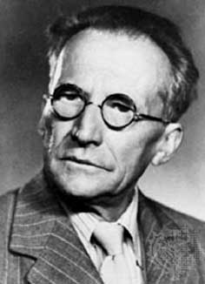
Coordinate representation and momentum representation (FYI)
Representation: The specific representation of states and mechanical quantities in quantum mechanics is called representation.
Wave function of coordinate representation
Give the probability that the particle is between at time t
Satisfies Schrödinger
For does not contain time t, then can separate variables x and t

Slide 123
Coordinate representation and momentum representation
Suppose the solution of the above state equation is
And suppose is orthonormal, namely,
The general solution of the time-dependent Schrodinger equation is
C_{n} is the superposition constant, determined by the initial conditions.
if
then
Momentum representation
Momentum operator
The corresponding eigenstate is P, and the eigenfunction is

Slide 124
Coordinate representation and momentum representation
Constitutes an orthogonal completeness set, the wave function of the system can be expaned with , namely,
Multiply both sides
Ψ(x, t) and φ(p, t) have a one-to-one correspondence
The |φ(p, t)|² dp give the probability that the particle is between p~p+dp at time t, or |φ(p, t)|² is the probability density of the particle’s momentum.
If the Ψ(x, t) is normalization, then the φ(p, t) is normalization

Slide 125
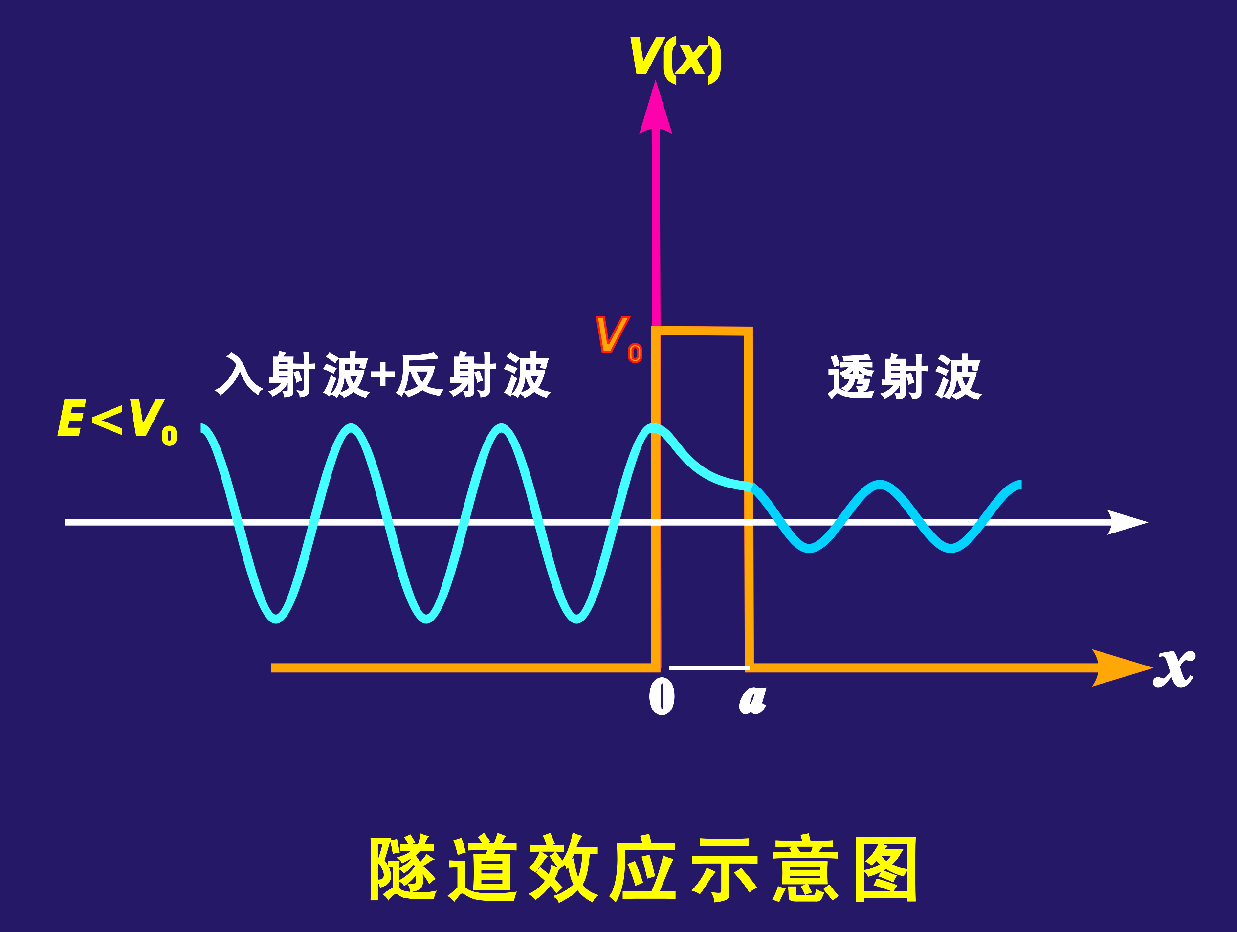
Finite barrier (V₀) and quantum mechanical tunneling effect (FYI)
The barrier height is a finite value V₀. when E< V₀, according to the classical mechanics point of view, the particle cannot pass through the barrier to reach the other side, but with quantum mechanics, the particle has a certain probability on the other side, which is the tunneling effect of quantum mechanics.
Its penetration coefficient is：

Slide 126
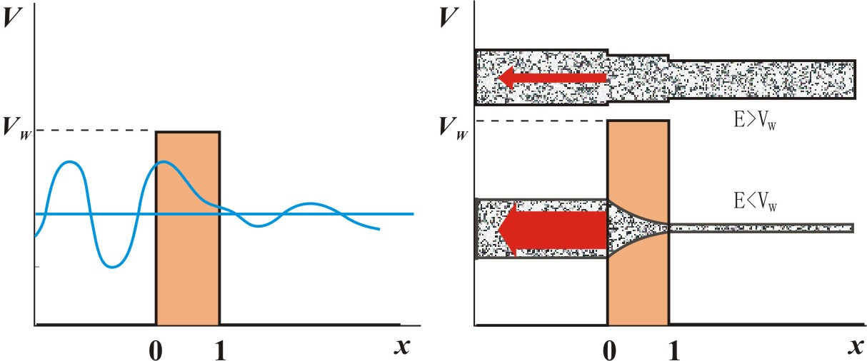
Consider the following problem: a beam of particles enters from the left, interacts with something (target), partially reflects, and partially penetrates the target and exits to the right.
The interaction between the target and the particle is generally represented by a potential energy function
Schematic diagram of matter wave passing through potential barrier
Schematic diagram of the probability of particles passing through the barrier and reflecting back

Slide 127
Scattering: the target is bombarded with a beam of incident particles, and then the particles leave. For example, bombarding gold foil with a particles.
The particularity of the scattering problem: particles are distributed throughout the space.
Bound state: The particles are mainly distributed in a limited area, and the wave function can be normalized. For example, the extranuclear electrons of a hydrogen atom are mainly distributed near the nucleus. As the distance from the nucleus increases, the wave function decreases rapidly.
Unbound state: Refers to the distribution of particles in any area of ​​space is important, and the wave function cannot be normalized by convention. For example, for a plane wave, the wave function is: ψ(x)=exp(i2πp_{x}x/h)。
The particles in the scattering problem are in an unbound state.
The concept and how to list the Schrodinger equation and boundary conditions must be mastered later!

Slide 128
List the Schrodinger equation of the particle, the target is represented by a potential energy function.
We limit 0<E<V₀, and solve the Schrodinger equation piecewise:
(1) x<0，V(x)=0
note
Since the potential energy is zero, the energy here represents kinetic energy, E=p²/(2m), so k=2pp/h, which represents momentum, and thus represents the direction of wave propagation.
General solution:
k>0, wave from left to right, incident
-k<0, wave from right to left, reflection

Slide 129
(2) 0<x<l，V(x)=V₀
Rember
Note: κ here is equivalent to ik_{II} in the book
Gneral solution:
(3) x>l，V(x)=0 Similar to situation (1)
Gneral solution:

Slide 130
To sum up, the general solution is:
Boundary conditions: the wave function is a good function. At the boundary, it is continuous with its first derivative, namely,
Six unknown parameters, only four conditions. Considering that there is only an emergent wave on the right side of the target, so b3=0. the term a₁ represents the incident particle, and other parameters are represented by a₁.

Slide 131
Solution:
Reflection coefficient：
Transmission coefficient:
Reflection coefficient + transmission coefficient = 1

Slide 132
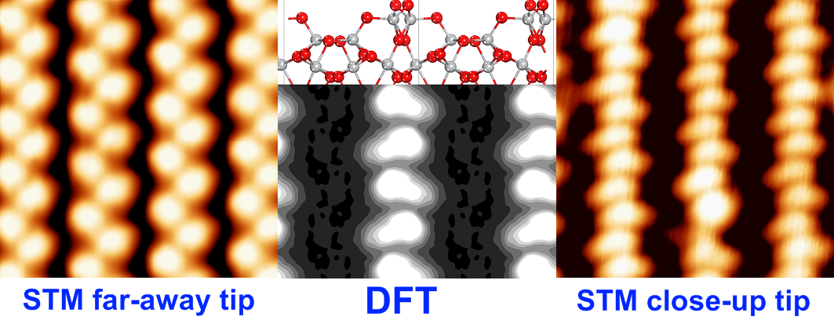
Application：
Probe
Air gap
Sample
STM working diagram

Slide 133
This wonderful quantum phenomenon cannot be explained by classical physics. The quantum mechanical tunneling effect is the core of many physical phenomenon and physical devices, such as tunneling diodes, supper conductiong Josophson junctions, and α decay. Certain proton transfer reactions are also related to the tunneling effect. For chemistry, the most significant is probably the scanning tunneling microscope (STM), invented based on the tunneling effect, with a magnification of 30 million times and a resolution of 0.01 nm. It enables humans to truly “see” a single atoms for the first time! This is one of the world’s major scientific and technological achievements in the 1980s.

Slide 134
The general method of quantum of mechanics
1. Write down the Hamiltonian of the system [H] (mainly the potential energy operator);
2. Write out the Sch. equation;
3. Solve the Sch. Equation. Treat Ψ as an unknown function and E as a parameter. Use the following conditions: ⑴ initial conditions; ⑵boundary conditions; ⑶qualified wave function conditions. A series of wave Ψ₁,Ψ₂,Ψ₃···and a series of corresponding energies E₁, E₂, E₃···can be obtained. Each Ψ_{i} represents a possible state of the system, and the energy of this state is E_{i}.
4. From the obtained Ψ_{i}, the probability disrtribution of the system and other physical properties of the system can be known.

Slide 135
Virial Theorem
1. Virial theorem is applicable to many stable complex systems (stable micro-macro)
2. Virial theorem points out the relationship between the average kinetic and potential energy of the system;
e.g., the Harmonic oscillator system:
Then: n=2
The atom and molecule system:
Then: n=-1

